Slide 1
Tour of the Planets
Winter 2012

Slide 2
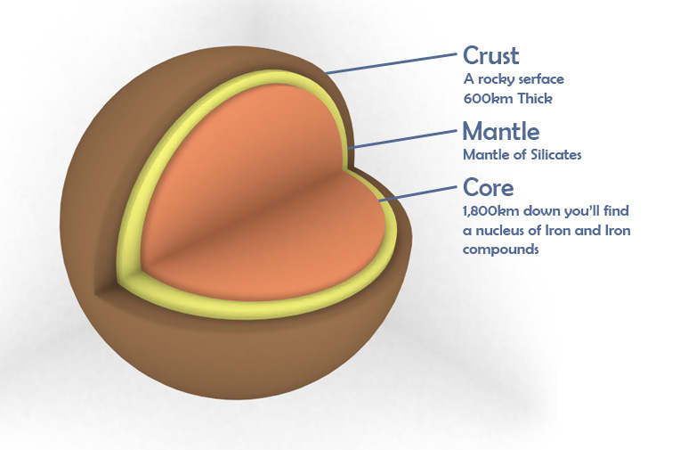
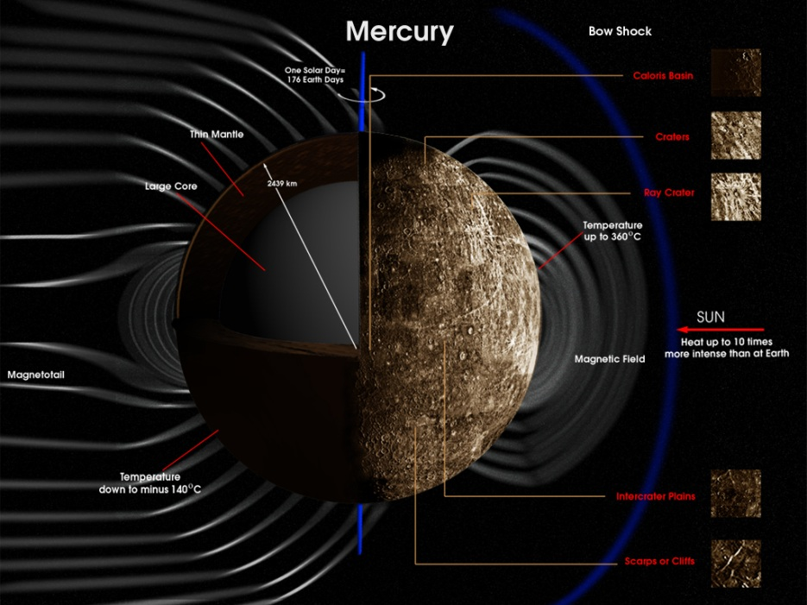
Mercury
Facts about Planet Mercury
Mercury is the fastest moving planet in our Solar System and is the nearest planet to the Sun. Mercury is one of the four terrestrial planets, being a rocky body like the Earth. It is the smallest of the four.
Diameter: 4,878km (3,032 miles) at its equator, which is about two-fifths of Earth's diameter.
Orbit: 57,910,000 km (0.38 AU) from Sun. Orbiting the Sun once every 88 days.
Time to Rotate: 58.6 days
Moons: 0
Period of Rotation: 58.6462 days.
James Pluim & Eddie Lopez

Slide 3
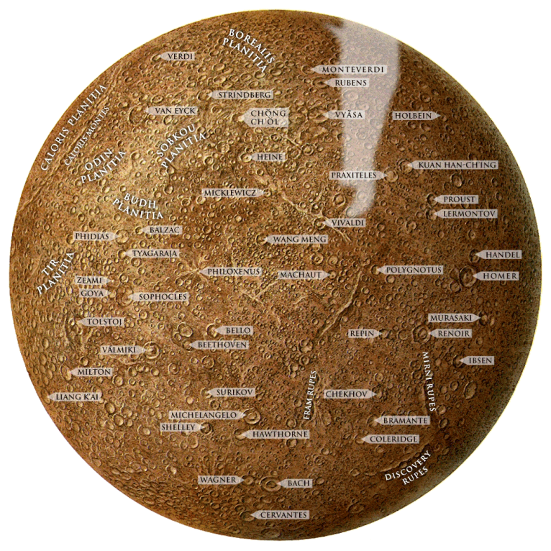
Mercury
History
Radar studies conducted in 1965 showed that the planet rotates once in about 59 days.
Orbit
Mercury has a very elliptical (oval-shaped) orbit. Mercury moves around the sun faster than any other planet.
Life
The plant and animal life of the Earth could not live on Mercury because of the lack of oxygen and the intense heat. Scientists doubt that the planet has any form of life.
Phases
When viewed through a telescope, Mercury can be seen going through ‘changes’ in shape and size.
James Pluim & Eddie Lopez

Slide 4
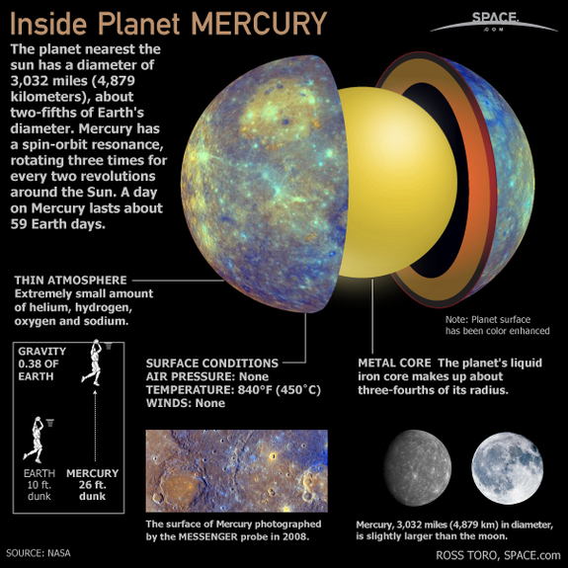
Mercury in 25 seconds
http://www.youtube.com/watch?v=U8-DTJpygyk
James Pluim & Eddie Lopez

Slide 5
Mercury
Sources:
INFORMATION:
http://www.windows2universe.org/mercury/Atmosphere/atmosphere.html
http://www.aerospaceguide.net/planet/planetmercury.html
IMAGERY/VIDEO:
http://www.youtube.com/watch?v=U8-DTJpygyk
James Pluim & Eddie Lopez

Slide 6
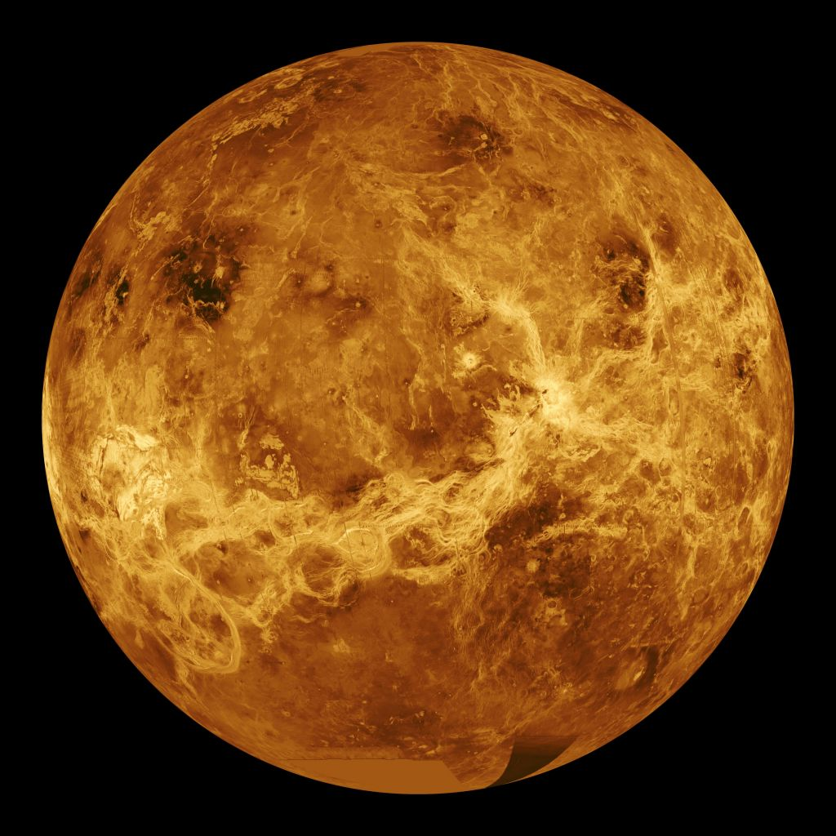
VENUS
Lee Hinds
Keenan Daufelt

Slide 7
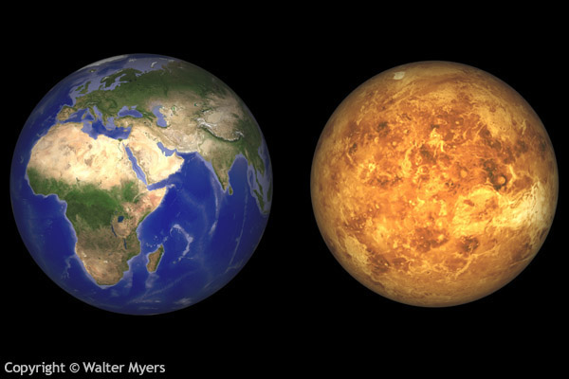
Overview
Sixth largest Planet
Earth’s “sister” planet because of size (95% of Earth) and distance from the sun.
Has zero moons
Spins backwards
One day is 243 Earth days.
One year is 225 Earth days.

Slide 8
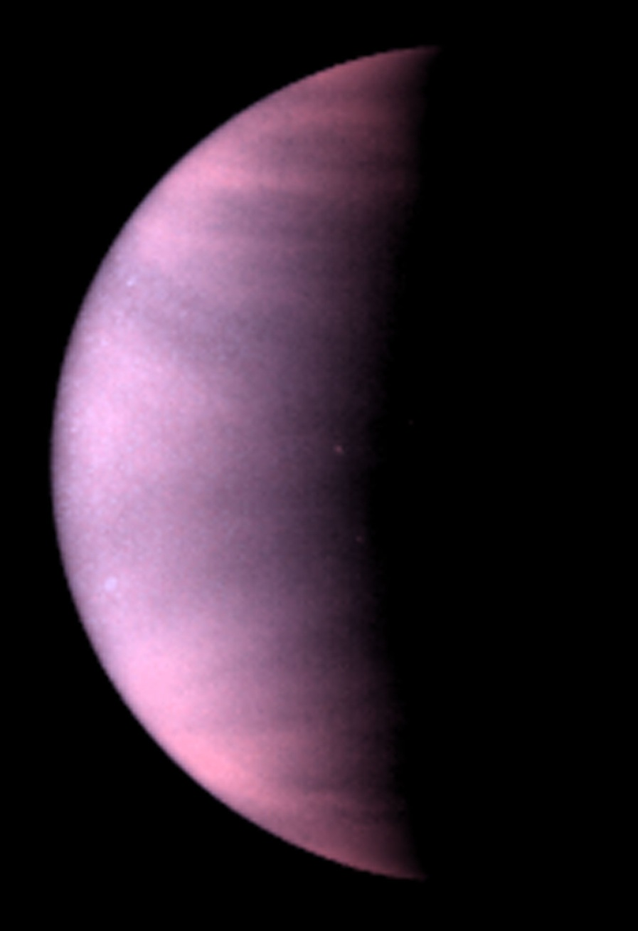
Weather/ Atmosphere
Hottest planet in our solar system
Thick atmosphere made of carbon dioxide.
Clouds are made of Sulfuric acid, so the rain is deadly.
Days can get up co 410 degrees Celsius

Slide 9
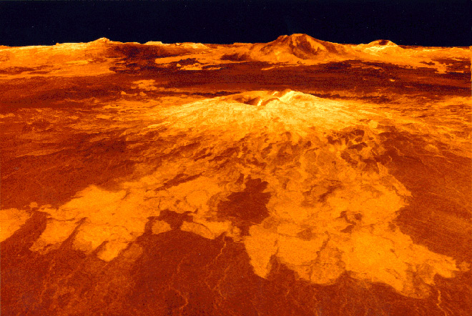
Terrain
Has 100,000+ active volcanoes.
Giant rolling plains with little relief
Highest point; Maxwell mountains, 11 kilometers high
Much like Earth, Venus had large amounts of water; now dry and barren.
Rain evaporates before hitting the ground.

Slide 10
Reference
http://space.about.com/od/solarsystem/tp/venus10things.htm
http://www.pbs.org/lifebeyondearth/alone/venus.html
http://photojournal.jpl.nasa.gov/catalog/PIA00266
http://www.universetoday.com/14306/temperature-of-venus/

Slide 11
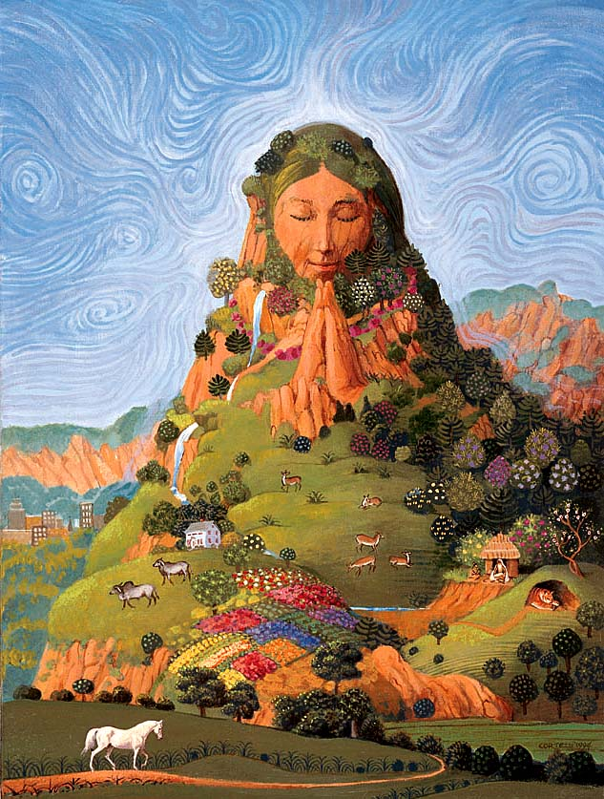
Mutha Earth

Slide 12
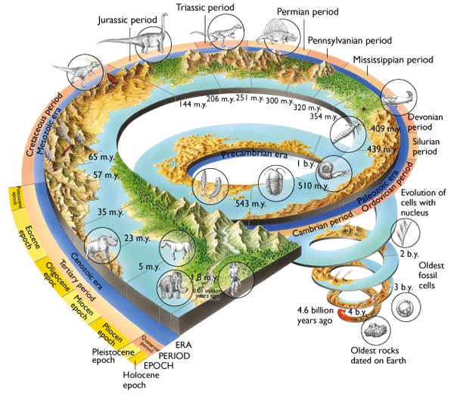
Geological Timeline

Slide 13
Earth's Future
http://www.youtube.com/watch?v=tv6p48v0meE

Slide 14
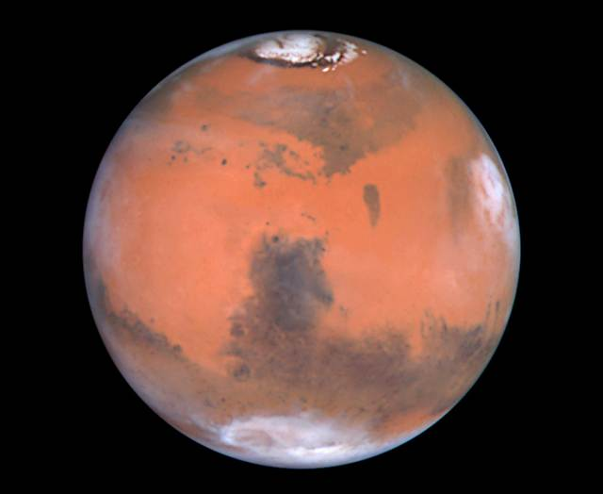
Mars
Jeanette Money & Jeff Stankaitis

Slide 15
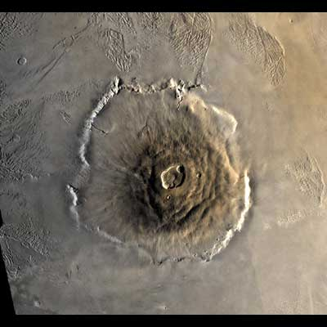
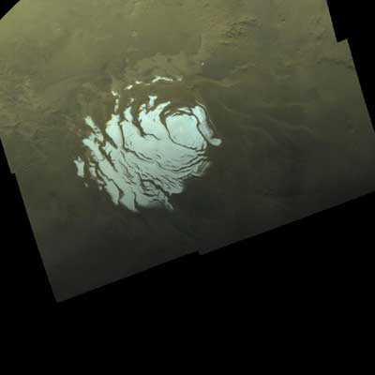
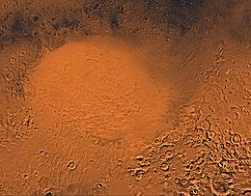
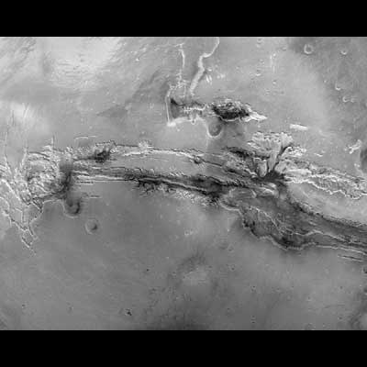
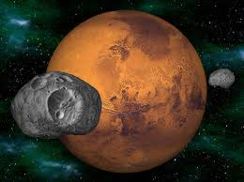
Physical Characteristics of Mars
Olympus Mons: Largest Volcano in Solar System. 3 times larger than Mt. Everest.
Polar Ice Caps: Expand and recede through seasons
Largest visible crater. 1,400 miles/23,000 feet deep
Valles Marineris: Largest canyon in Solar System. 2400 Miles & 5 miles deep.
Phobos & Deimos. Many eclipses

Slide 16
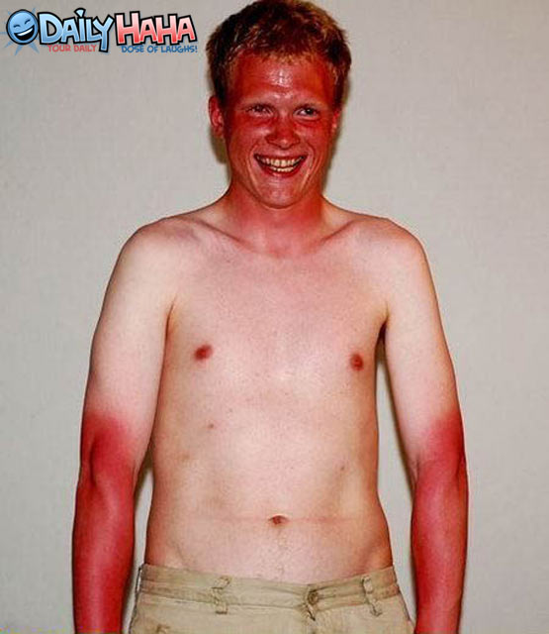
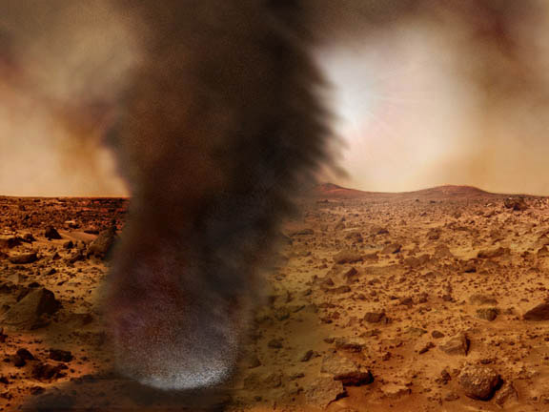
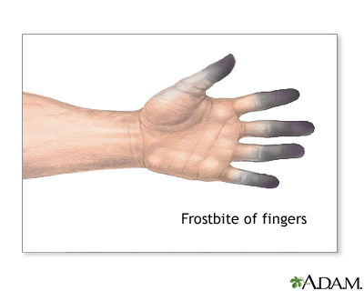
Atmosphere and Weather
Temperatures range from -190F to 90F
http://www.astronomy.com/en/News-Observing/Astronomy%20Kids/2008/03/Mars.aspx
Thinner atmosphere
Heavy Sandstorms

Slide 17
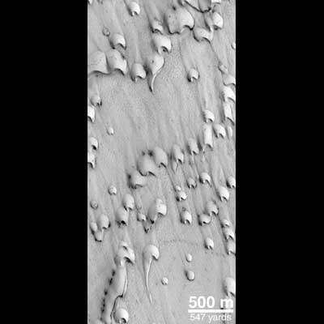
Interesting Fact!
Frost on Sand Dunes!
http://pds.jpl.nasa.gov/planets/captions/mars/dunes.htm

Slide 18
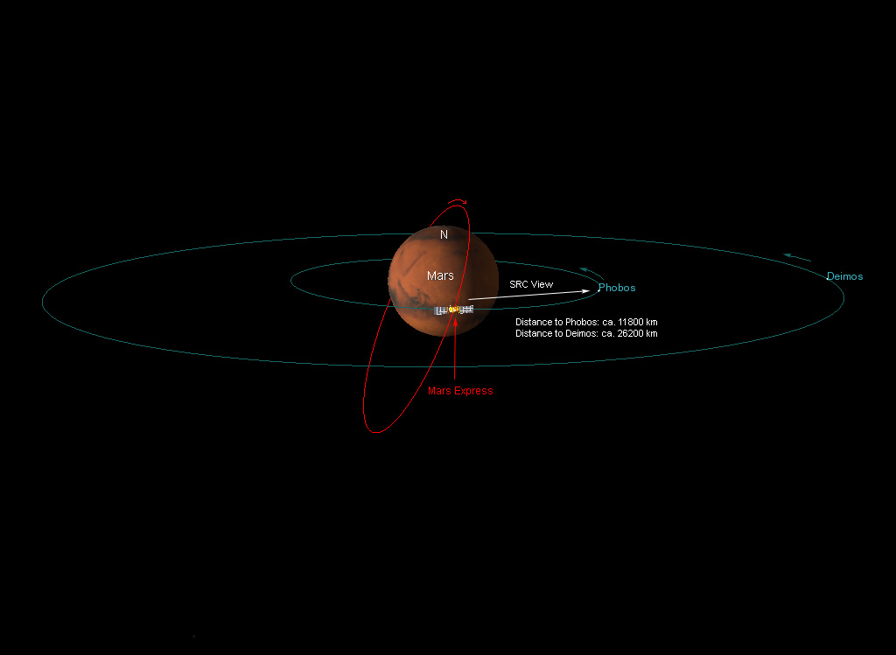
Size, Location, Rotation
Picture Source
142 million miles from sun
687 Earth days to one year
24 hours 37 minutes per day

Slide 19
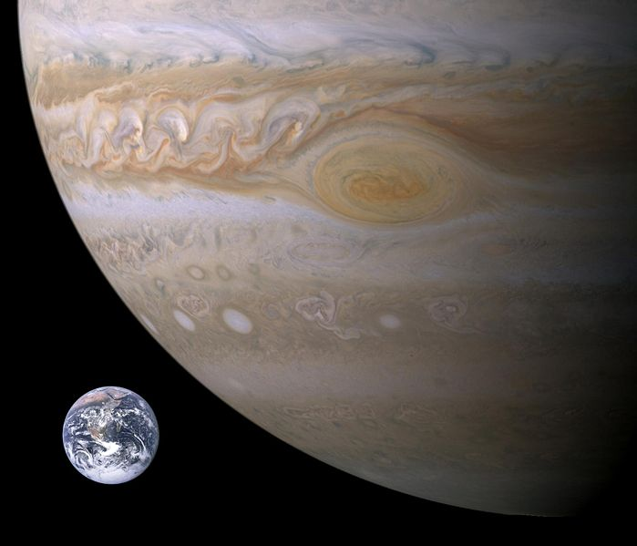
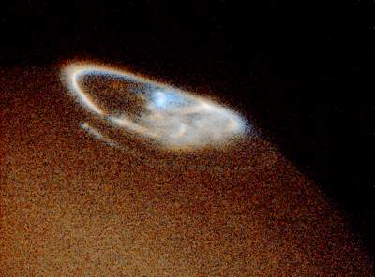
Jupiter jeffrey and nicole
5.20 Au from the Sun
4th brightest object in the sky
318 times the mass of earth
Has Northern and southern lights
11.86 years is one Jupiter year

Slide 20
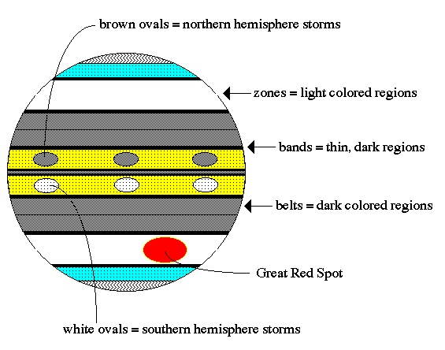
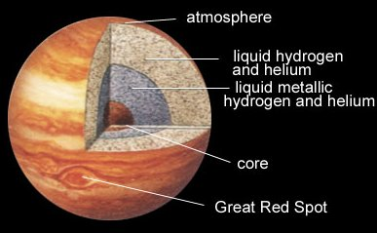
Jupiter jeffrey and nicole
Radiates more energy then it receives from the sun
Core 20,000k
Magnetosphere extends past the orbit of Saturn 650mil km

Slide 21
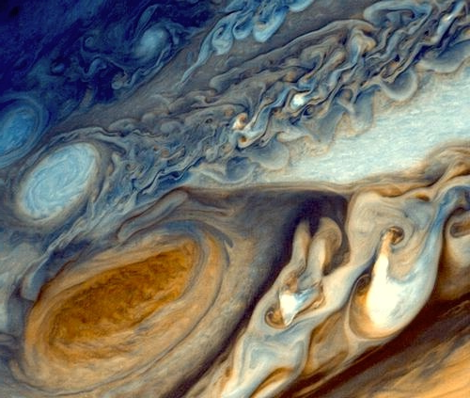
Great red spot jeffrey and nicole
Has been observed for more than 300 years
12,000 by 25,000 km can hold 2 earths

Slide 22
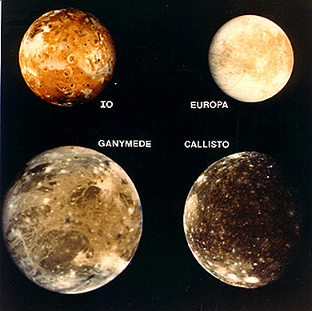
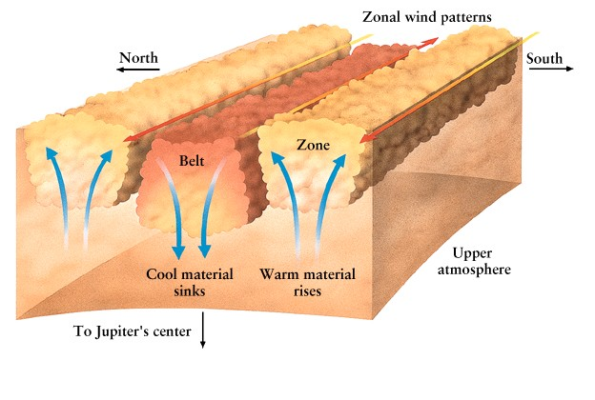
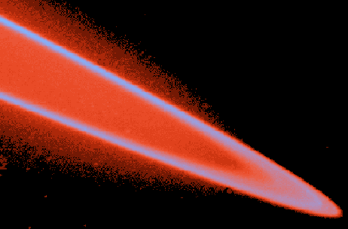
What orbits Jupiter jeffrey and nicole
63 known satellites,3 sets of rings
4 larges Galilean moons
90% hydrogen 8% helium and 2% other

Slide 23
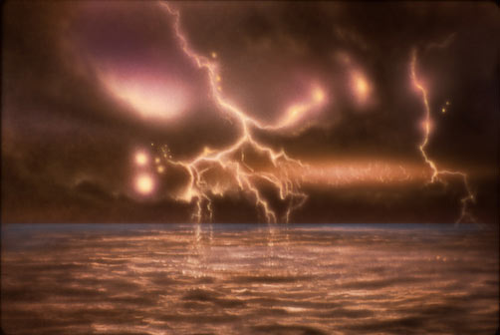
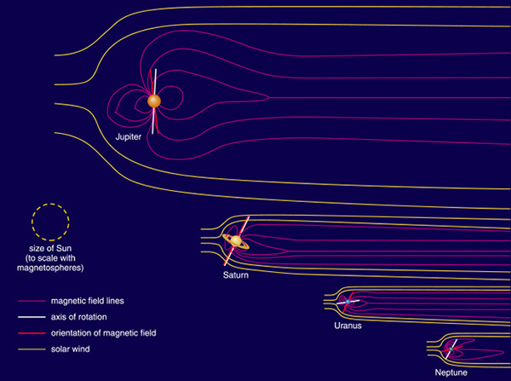
Jupiter's surface jeffrey and nicole
Surface is Liquid Metallic Hydrogen
LMH is electrical conductor and is the source of Jupiter's magnetic field

Slide 24
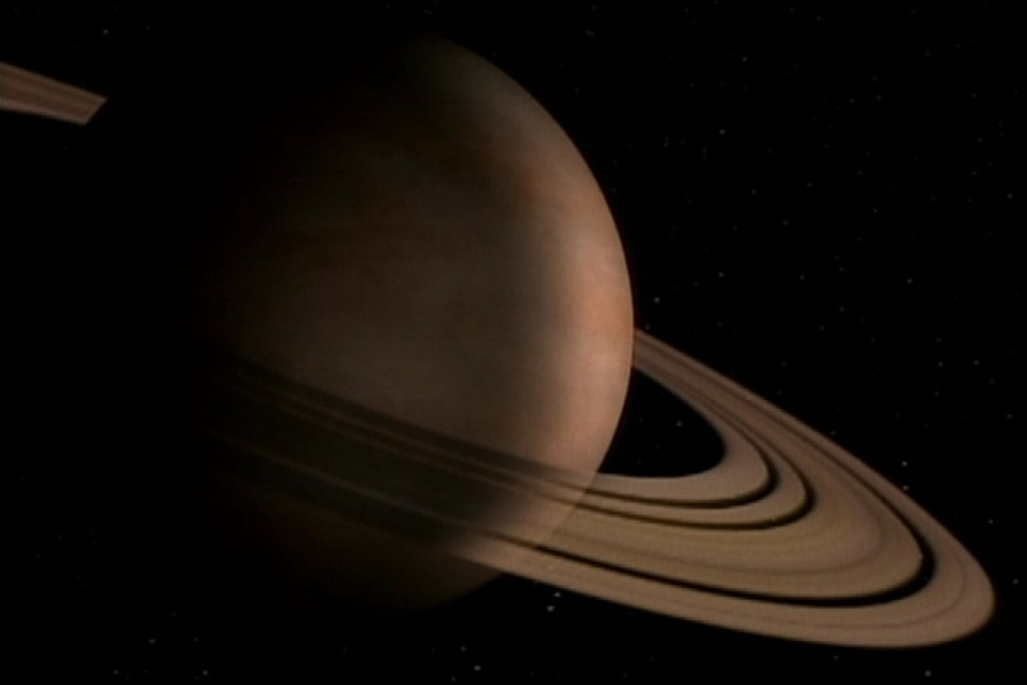
Saturn
William Smith, Omar

Slide 25
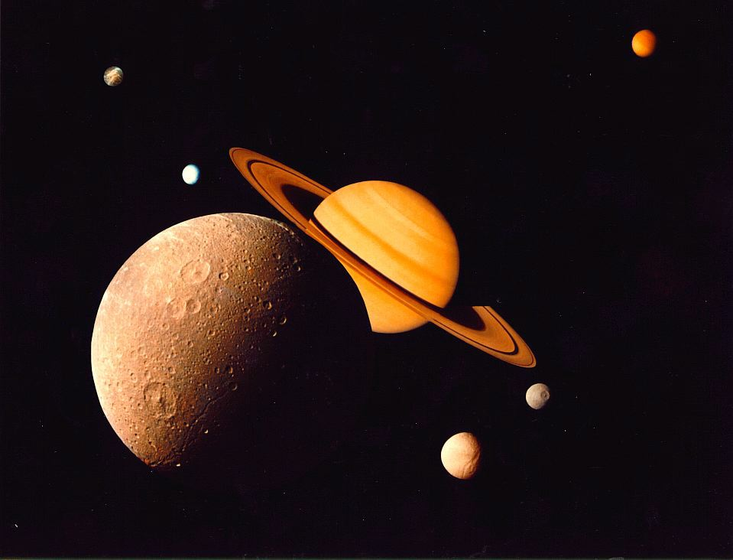
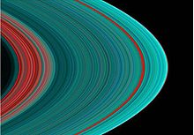
62 moons, 53 have formal names
Titan, the largest moon, contains 90% of the mass in orbit around Saturn
93% of the material in Saturn's rings are composed of water ice with tholin impurities.

Slide 26
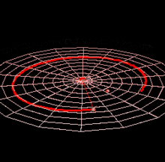
Avg distance is over 9 AU
Takes 29^{1/2} earth years for one Saturnal year.
In sep. 2007 rotation was 10 hrs 32 mins and 35 Secs.
http://upload.wikimedia.org/wikipedia/commons/9/95/Saturn_Orbit.gif

Slide 27
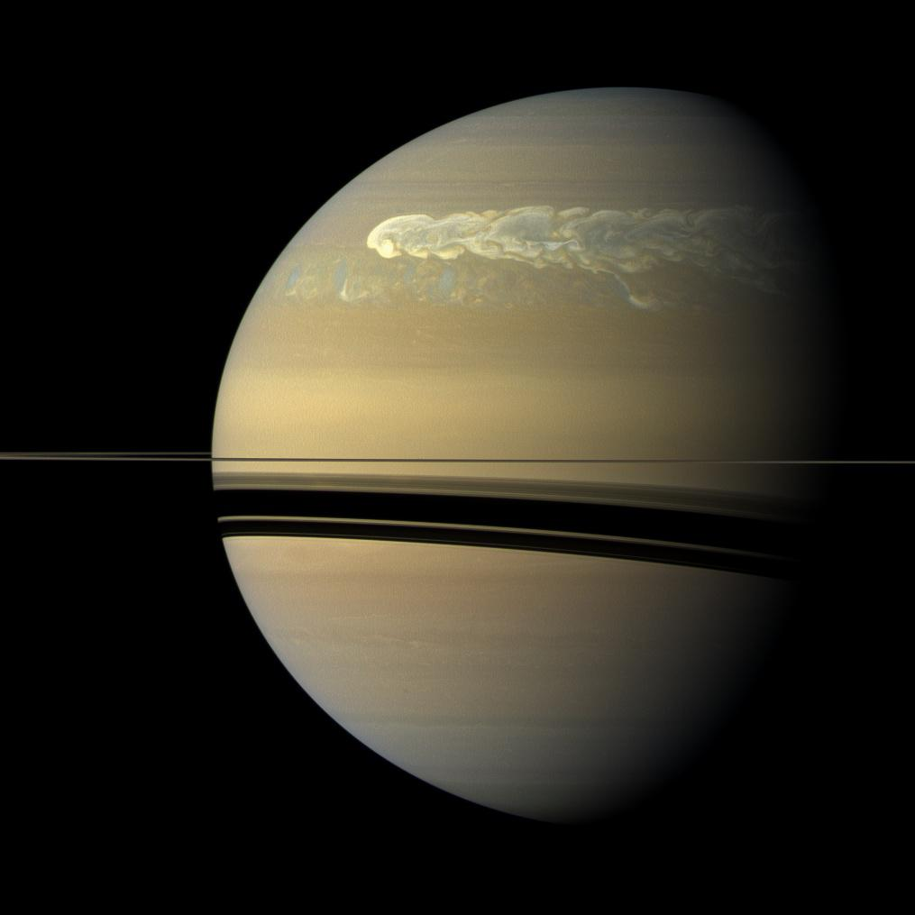
Banded pattern similar to Jupiters, although much fainter
Much more pressure towards center
Upper clouds contain ammonia crystals, lower level clouds consist of either ammonium hydrosulfide or water

Slide 28
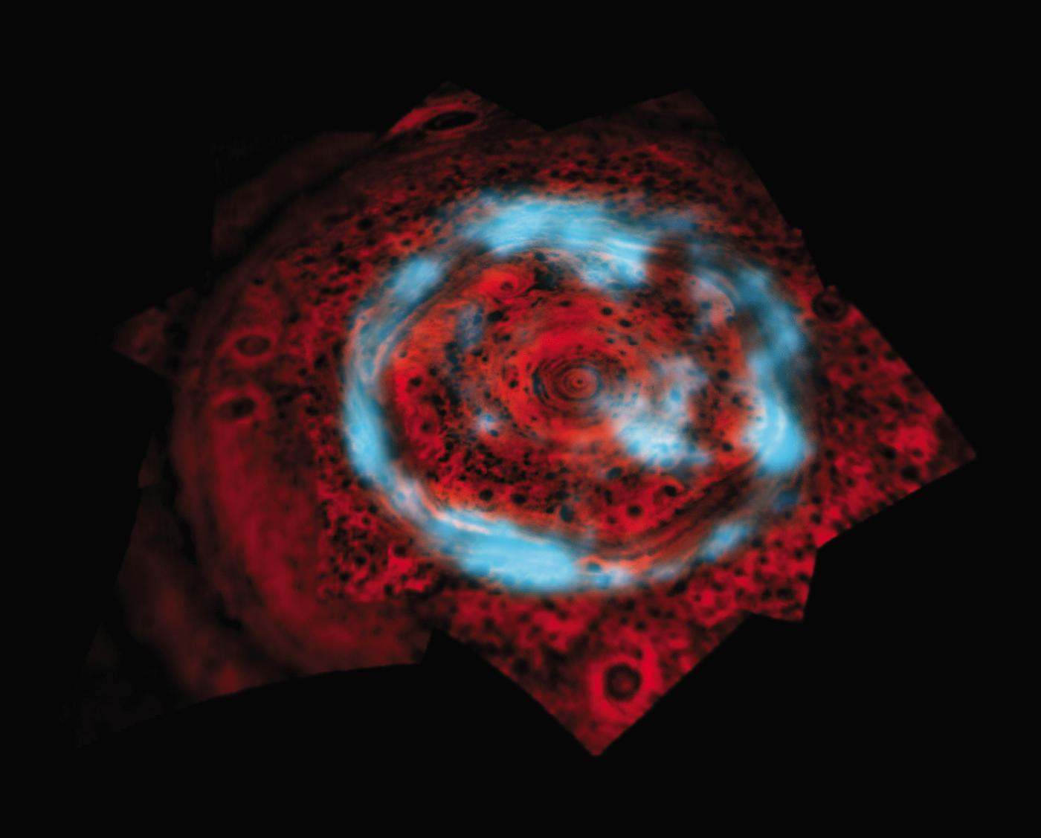
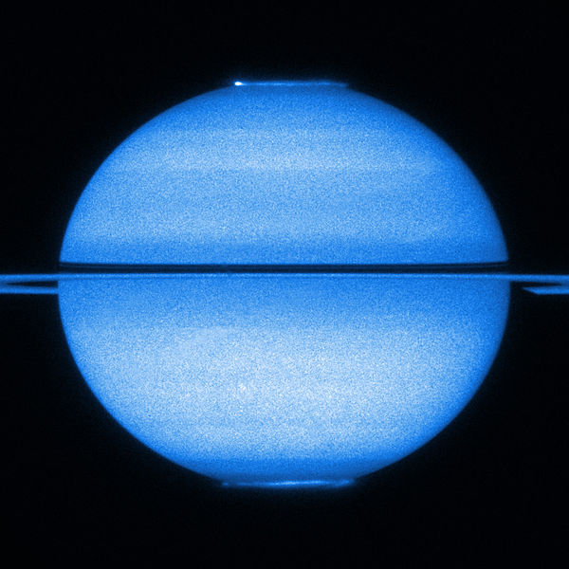
Magnetosphere is simple symmetric shape
Slightly weaker than Earths at the equator
Like earths it produces aurorae

Slide 29
Uranus
Robert Romero
Angela Pagano
NASA webpage

Slide 30
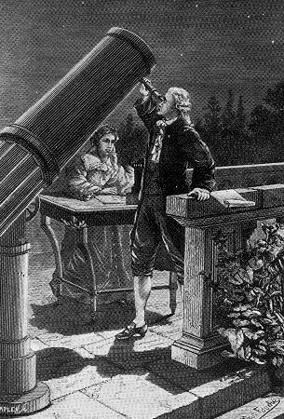
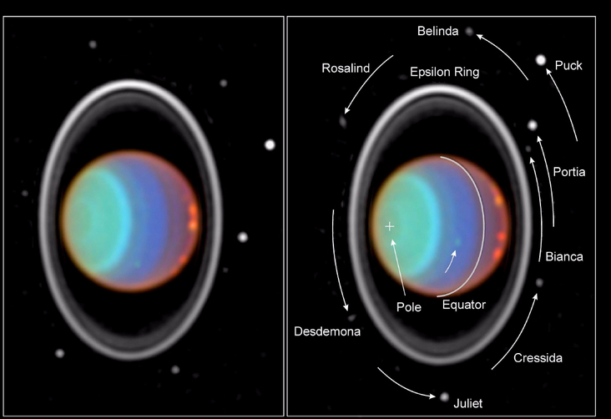
Just the Facts
Discovered in 1781 by astronomer William Herschel
The first planet ever found with the aid of a telescope.
7th planet from the sun
Its mass is over 14 times larger than earth
The core is icy materials such as; water, methane, and ammonia
Temperature: -322.87° F
Distance from Sun: 1,783,939,400 miles
Rotation period: 17.24 hours
klima-luft.de/steinicke/ngcic/persons/herschel_w
NASA webpage

Slide 31
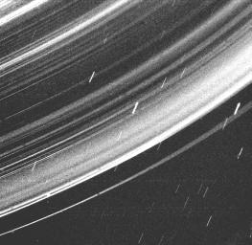
It’s tilt
It is the only giant planet that’s equator is nearly at right angles to its axis
A collision with an object close to the size of the Earth may be the reason for its strange tilt.
The magnetic axis is tilted around 60° from the planet’s axis rotation
Methane gives Uranus its blue tint
Sun light passes through the atmosphere, methane gases absorb the red light and extend the blue.
Uranus has 13 faint rings made up of particles and dust
NASA webpage

Slide 32
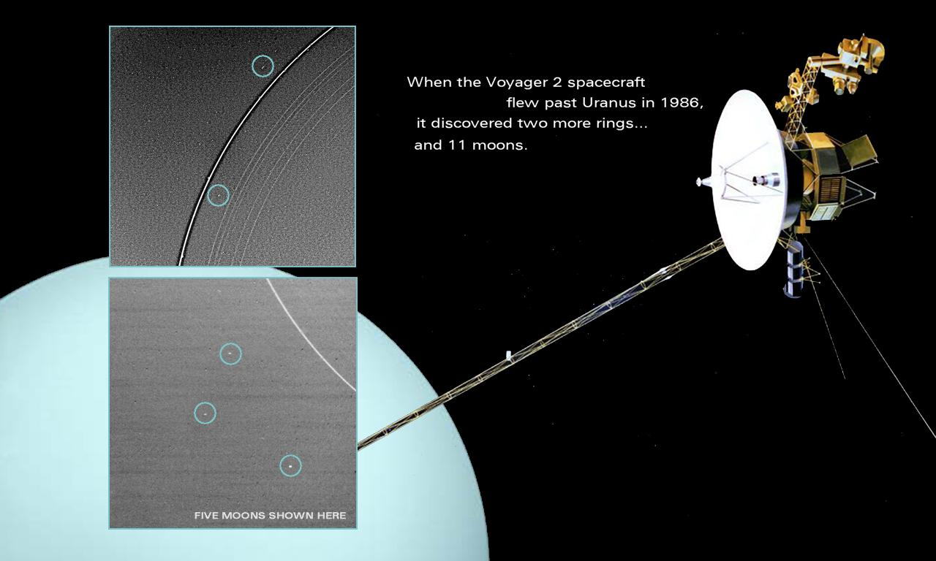
More facts
83% Hydrogen and 15% Helium and 2% Methane
2nd least dense planet, after Saturn
84 Earth years to complete one orbit
It is one of two ice giants in our Solar System
Most of what we know about Uranus came from Voyager 2's flyby in 1986.
pds-rings.seti.org/uranus/viewspace/page20.html
http://www.youtube.com/watch?v=-ElXNcGxNMo

Slide 33
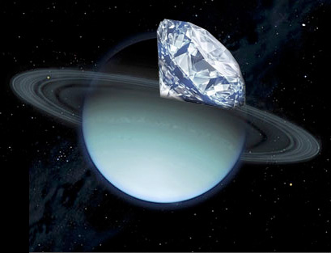
Fun facts
Some nights last up to 40 years due to the strange way it spins
It is the coldest planet in the solar system
You can see Uranus without a telescope by simply looking into the night sky.
Oceans of liquid diamonds filled with solid diamond icebergs
newsline.llnl.gov/_rev02/labNews/2009/nov/11.20.09-labNews.php
http://www.youtube.com/watch?v=QB1k12Dao1w

Slide 34
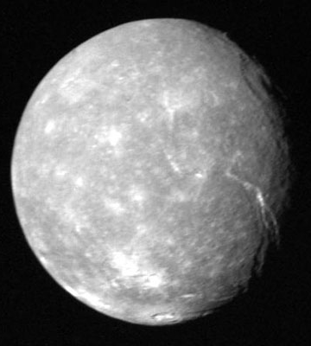
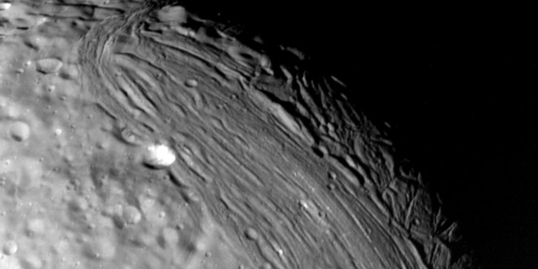
Moons
27 known moons named after characters from works of William Shakespeare or Alexander Pope.
Titania is the largest moon consisting of equal amounts of ice and rock.
Oberon is the second largest and also consists of equal amounts of ice and rock.
Miranda is the smallest of the five major moons. Icy material is drifting to the surface and its surface may indicate partial melting of its core.
NASA webpage
NASA webpage

Slide 35
Citations
http://solarsystem.nasa.gov/planets/profile.cfm?Object=Uranus
Planetary.org
newsline.llnl.gov/_rev02/labNews/2009/nov/11.20.09-labNews.php

Slide 36
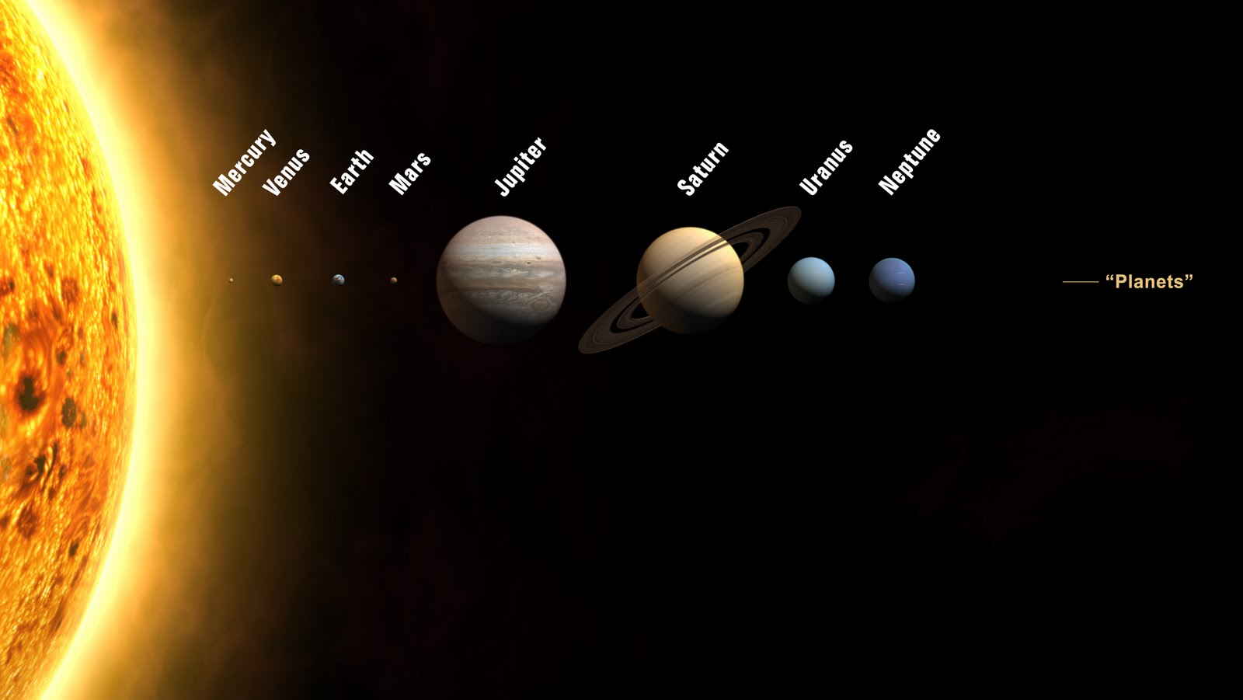
Neptune
NEPTUNE
The fourth-largest planet
Has 13 moons
Neptune trudges through space, taking 165 earth years to orbit the sun

Slide 37
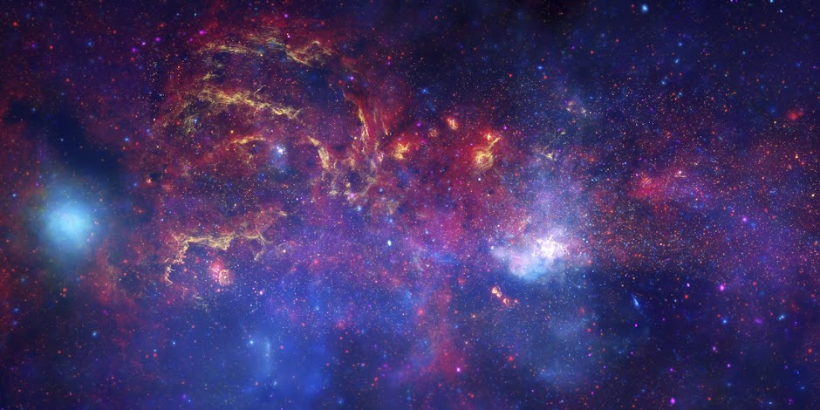
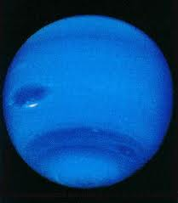
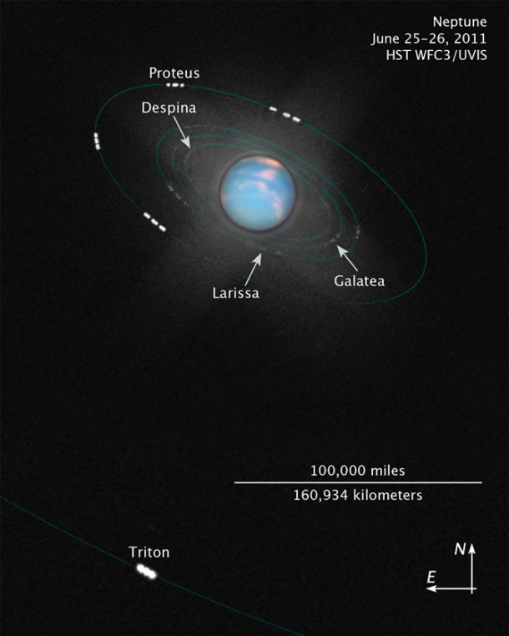
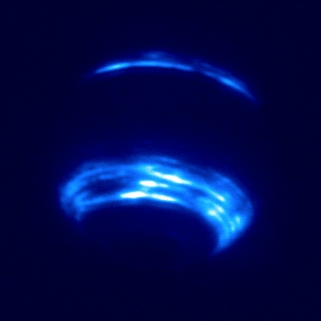
NEPTUNE
Viewing Neptune through infrared!

Slide 38
Neptune
NEPTUNE
Neptune is the eighth planet from the sun
2.7 million miles away from the star it orbits
It is 30 times farther from the sun than is Earth.
Mainly composed of hydrogen, helium, and water.
Sources:
http://www.happynews.com/living/space/neptune-facts-information.htm
By: Kelly McDonald and Erik Holiday

Slide 39
DwaRF Planets
Torres and Santarin Fools!

Slide 40
What exactly IZZZ a Dwarf?
A Dwarf in astronomical terms can refer to either a planet or a star
Dwarf Stars – Main Sequence Stars / Luminosity Class V
Dwarf Planet – A small planet.
(Looks like a planet… acts like a planet… smells like a planet… it MUST be a planet… Only smaller.)

Slide 41
What exactly IZZZ a Dwarf?
A Dwarf in astronomical terms can refer to either a planet or a star
Dwarf Stars – Main Sequence Stars / Luminosity Class V
Dwarf Planet – A small planet.
(Looks like a planet… acts like a planet… smells like a planet… it MUST be a planet… Only smaller.)

Slide 42
Types of Dwarfs (They sound racist but they’re not.)
Red Dwarfs
Yellow Dwarfs
Blue Dwarfs?
White Dwarfs
Black Dwarfs
Brown Dwarfs
These are all STARS btw :-P

Slide 43
Dwarf Planets… (Like the Canada’s of space)
List of Dwarf Planets in our Solar System:
Ceres*
Pluto*
Haumea
Makemake
Eris*
(out of the 5 planets people, apparently, only cared about 2 of them)

Slide 44
Sizes of the Planets
Brandon Kummer
Ruth Rubio

Slide 45
Comparing Planets
Earth is 1.05 the ratio of Venus
Earth is 1.88 the ratio of Mars
Earth is 2.54 the ratio of Mercury
Earth is a whopping 5.55 the ratio of Pluto (dwarf planet)

Slide 46
Planet Sizing
Earth is 7,926 ml
Neptune is 30,832 ml
Uranus is 31,784 ml
Saturn is 74,586 ml
Jupiter is 88,694 ml
With Earth being a ratio of 1, Jupiter’s ratio is 11.1

Slide 47
Sun
The Sun’s diameter is 856029 ml
It fits 625 Plutos across
It fits 108 Earths across
It fits 9.68 Jupiters across

Slide 48
Stars
Arcturus is 16-28 times as wide as the Sun.
Antares is the 15th brightest star in the sky. It is more than 1,000 light years away.
For comparison, the Sun would be less than 1/5 of a pixel wide on the right image.

Slide 49
Video
http://www.youtube.com/watch?v=HEheh1BH34Q

Slide 50
Sources
http://www.co-intelligence.org/newsletter/comparisons.html
http://www.youtube.com/watch?v=HEheh1BH34Q
http://www.kiroastro.com/writings/perspective
http://www.angelfire.com//sc2/Trunko/stars.html

Slide 51
Planets!
A journey through their years, and days…of the planets.
Montesanto, and Wolf

Slide 52
Informational Chart, with information.
Planet (or Dwarf Planet) | Distance from the Sun (Astronomical Units miles km) | Period of Revolution Around the Sun (1 planetary year) | Period of Rotation (1 planetary day)
Mercury | 0.39 AU, 36 million miles 57.9 million km | 87.96 Earth days | 58.7 Earth days
Venus | 0.723 AU 67.2 million miles 108.2 million km | 224.68 Earth days | 243 Earth days
Earth | 1 AU 93 million miles 149.6 million km | 365.26 days | 24 hours
Mars | 1.524 AU 141.6 million miles 227.9 million km | 686.98 Earth days | 24.6 Earth hours =1.026 Earth days
Jupiter | 5.203 AU 483.6 million miles 778.3 million km | 11.862 Earth years | 9.84 Earth hours
Saturn | 9.539 AU 886.7 million miles 1,427.0 million km | 29.456 Earth years | 10.2 Earth hours
Uranus | 19.18 AU 1,784.0 million miles 2,871.0 million km | 84.07 Earth years | 17.9 Earth hours
Neptune | 30.06 AU 2,794.4 million miles 4,497.1 million km | 164.81 Earth years | 19.1 Earth hours
Pluto (a dwarf planet) | 39.53 AU 3,674.5 million miles 5,913 million km | 247.7 years | 6.39 Earth days
Planet (or Dwarf Planet) | Distance from the Sun (Astronomical Units miles km) | Period of Revolution Around the Sun (1 planetary year) | Period of Rotation (1 planetary day)

Slide 53
Fun Facts!
The longest day is Venus, and the shortest day is Jupiter.
A day on Venus is longer than its year.
Each planet speeds up when it is nearer the Sun and travels more slowly when it is far from the Sun.
Our moon’s day is 27.32 Earth days.
Mar’s moon, Phobos’ day is: 7hrs 40 mins.
Deimos’ day is 30 Earth hours.

Slide 54
Information video and such.
http://www.youtube.com/watch?v=9-fMQiE-xFE
This video gives a very short example of why planets speed up when they’re closer to the sun.

Slide 55
Terrestrial Planets Atmosphere by Omar Castaneda and Carolina Cecena
Mercury
The atmosphere of Mercury is composed of:
Carbon dioxide 95.32%
Nitrogen 2.7%
Argon 1.6%
Oxygen 0.13%
Carbon monoxide 0.07%
Water vapor 0.03%
Nitric oxide .0013%
Trace gases(including krypton and methane among others)
Venus
The atmosphere of Venus is composed of about 96% carbon dioxide, with most of the remainder being nitrogen.

Slide 56
Terrestrial Planets Atmosphere
Earth
the present composition of the atmosphere is 79% nitrogen, 20% oxygen, and 1% other gases.
Mars
Mars has more carbon dioxide in its atmosphere than does Earth, but Mars has a lot less of everything else.In cold weather, find H₂O frost on the surface.
There is CO₂ ice in polar caps. Most of it evaporates in summer.
Water ice in the polar caps.

Slide 57
Jovian Planets Atmosphere
Jupiter
It has been suggested that the colors result either from colorful hydrogen compounds welling up from warmer regions, or from colorful compounds associated with trace amounts of elements like sulfur in the atmosphere.
Saturn
The atmosphere of Saturn, like Jupiter, is only a narrow region, compared to the vast interior of Saturn. The three clouddecks of Saturn are to be found mostly low in the atmosphere, while hazes of smog can be found higher up.

Slide 58
Jovian Planets Atmosphere
Uranus
The atmosphere of Uranus is composted mainly of molecular hydrogen and helium. The third most abundant molecule after hydrogen and helium is methane (CH₄). It’s the methane in Uranus’ atmosphere that absorbs the red spectrum visible light and gives it the blue-green color.
Neptune
Neptune’s atmosphere comprises mostly of hydrogen and helium with a small amount of methane. The thick atmosphere has about 74% hydrogen, 25% helium and about 1% methane.

Slide 59
Temperature
Taesha Taylor
Terrell Parker

Slide 60
Jovial Planets Temperature ranges
Jupiter is 120K=-153 degrees Celsius -244 degrees Fahrenheit
Saturn is 88K -185 Celsius -290 Fahrenheit
Uranus is 59K -350 Fahrenheit
Neptune s 48K

Slide 61
Terrestrial Planets Temperatures
Mercury is -270 Fahrenheit to 800
Venus is 726 K (452°C = 870°F).
Earth -127°F to 136°F (-88°C to 58°C; 185 K to 311 K
Mars -81 °F (-63 °C). low of -220° F(-140° C)

Slide 62
Jovial VS. Terrestrial
http://www.youtube.com/watch?v=ldF9FQ8hK3A

Slide 63
References
Google. (2012, Feb 14). Google Images. Retrieved Feb 14, 2012, from Google Images: http://www.google.com/imgres?hl=en&biw=1366&bih=477&tbm=isch&tbnid=sqwJQQsLOPqJHM:&imgrefurl=http://www.giantworlds.org/family_of_the_sun.php&docid=y7kpL-MoIDkghM&imgurl=http://www.giantworlds.org/images/solar_system1.jpg&w=500&h=314&ei=Yik7T-b8MM-ftwfJtp
learning, e. (2012, feb 14). all about astronomy. Retrieved feb 14, 2012, from enchanted learning: http://www.enchantedlearning.com/subjects/astronomy/planets/mars/
Youtube. (2012, Feb 14). Planet tempture. Retrieved Feb 14, 2012, from youtube: http://www.youtube.com/watch?v=ldF9FQ8hK3A

Slide 64
Composition
Andre Elias
Barbara Ubando

Slide 65
Jovian Planets
Jupiter, Saturn, Uranus, and Neptune are gas planets composed of hydrogen and helium.
Jupiter: Hydrogen 90% Helium 9%
Saturn: Hydrogen 88% Helium 11%
Uranus: Hydrogen 83% Helium 15% Methane 2%
Neptune: Hydrogen 75% Helium 25% Methane 1%

Slide 66
Terrestial Planets
Mercury, Venus, Earth, and Mars are composed primarily of rock and metal.
Mercury:
Venus: 20% ofsolidified lava 70% of rolling uplands 10% highlands

Slide 67
Terrestial Planets cont.
Earth: 78% nitrogen, 21% oxygen, 0.9% argon, 0.03% carbon dioxide, and trace amounts of other gases.
Mars: Crust and surface made of iron-rich basaltic rock, mantle is

Slide 68
References
1994 - 2011 © Copyright Nine Planets - A guide to our solar system and beyond. [http://nineplanets.org/overview.html]
Jupiter Composition[http://abyss.uoregon.edu/~js/ast221/lectures/lec15.html]
General Information on Uranus [http://www.enchantedlearning.com/subjects/astronomy/planets/uranus/]
Inside Neptune [http://www.enchantedlearning.com/subjects/astronomy/planets/neptune/]
Inside Mercury [http://www.enchantedlearning.com/subjects/astronomy/planets/mercury/]
Inside Venus [http://www.enchantedlearning.com/subjects/astronomy/planets/venus/venusinside.shtml]
Inside Earth [http://www.enchantedlearning.com/subjects/astronomy/planets/earth/Inside.shtml]
Inside Mars [http://www.enchantedlearning.com/subjects/astronomy/planets/mars/]
Jovian Planets Image [http://www.google.com/imgres?imgurl=http://www.physics.uc.edu/~sitko/Fall2002/11-JPint/jp-int_files/image002.gif&imgrefurl=http://www.physics.uc.edu/~sitko/Fall2002/11-JPint/jp-int.html&h=298&w=432&sz=56&tbnid=idkE5cXmFqlfcM:&tbnh=95&tbnw=137&prev=/search%3Fq%3Djovian%2Bplanets%26tbm%3Disch%26tbo%3Du&zoom=1&q=jovian+planets&docid=ggbasnEGmGSw1M&sa=X&ei=WiY7T8YKheG2B4yvnPUK&ved=0CDkQ9QEwAQ&dur=352]

Slide 69
Moons
By: Hiram Cruz
Kris Szlakowski
Astronomy 2012

Slide 70
Total moons in our solar system: 153* *156 if you count pluto as a planet

Slide 71
MOONS PER PLANET
Jupiter view from Io

Slide 72
Terrestrial moon
MERCURY: 0
VENUS: 0
EARTH: 1 (Luna)
MARS: 2 (Phobos, Deimos)
Martian Moons
Phobos & Deimos
Earth Moon Luna
Reference: http://www.go-astronomy.com/planets/planet-moons.htm

Slide 73
JOVIAN PLANETARY MOON COUNT AND NAMES
JUPITER: 63
Io, Europa, Ganymede, Callisto (Galilean moons); Amalthea, Himalia, Elara, Pasiphae, Sinope, Lysithea, Carme, Ananke, Leda; Metis, Adrastea (shepherd moons); Thebe and more…
SATURN: 61
Titan, Rhea, Iapetus, Dione, Tethys, Enceladus, Mimas, Hyperion; Prometheus, Pandora (shepherd moons); Phoebe, Janus, Epimetheus and more…
URANUS: 27
Cordelia, Ophelia, (shepherd moons);Bianca, Cressida, Desdemona, Juliet, Portia, Rosalind, Belinda, Puck, Miranda, Ariel, Umbriel, Titania, Oberon, Caliban, Sycorax, Prospero, Setebos, Stephano, Trinculo (+ 6 unnamed moons)
NEPTUNE: 13
Triton, Nereid, Naiad, Thalassa, Despina, Larissa, Proteus, Galatea (shepherd moon)(+ 5 unnamed moons)
Reference: http://www.go-astronomy.com/planets/planet-moons.htm

Slide 74
VIDEO: Exploring the moons in our Solar System
http://www.youtube.com/watch?v=QHAdnHPF8WU
-European Space Agency (ESA)

Slide 75
Magnetosphere

Slide 76
What is a Magnetosphere ?
A magnetosphere is that area of space, around a planet, that is controlled by the planets magnetic field.

Slide 77
G4 Geomagnetic Storm / Magnetosphere Simulation Aug 5, 2011
http://youtu.be/cDdrm4uD8B0

Slide 78
Earth and Jupiter Magnetosphere

Slide 79
Planets with Magnetospheres
Neptune
Jupiter
Mercury
Saturn
Mars
Earth(Strongest)

Slide 80
Credits
http://images.wikia.com/marveldatabase/images/5/52/X-Men_Legacy_Vol_1_259_Marvel_Comics_50th_Anniversary_Variant_Textless.jpg
http://3.bp.blogspot.com/-Os5Zlwb7Hhs/Tf_Ob65WYWI/AAAAAAAAAdE/XhUXndVRZ4I/s400/Earth-magnetic-field410.jpg
http://physics.uoregon.edu/~jimbrau/BrauImNew/Chap11/FG11_20.jpg
http://www.thefreeresource.com/magnetosphere-has-anyone-ever-traveled-beyond-the-earths-magnetosphere

